Slide 1
Map Reduce
Dr. Preethi Ananthachari
AI & BigData Dept
Endicott college of International Studies
Preethi.ga@wsu.ac.kr

Slide 2
Map Reduce Job
MapReduce Job or a A “full program” is an execution of a Mapper and Reducer across a data set.
It consists of the input data, the MapReduce Program, and configuration info.

Slide 3
Task in MapReduce
A task in MapReduce is an execution of a Mapper or a Reducer on a slice of data.
It is also called Task-In-Progress (TIP).
It means processing of data is in progress either on mapper or reducer.

Slide 4
Task Attempt
Task Attempt is a particular instance of an attempt to execute a task on a node.
Anytime any machine can go down.
During processing – any machine – down – Reschedule the process to another node.
The default value of task attempt is 4.
If a Task fails 4 times, then it is failed job.
For high priority jobs, task attempt can be increased.

Slide 5
Map Abstraction
The map takes key/value pair as input. Whether data is in structured or unstructured format, framework converts the incoming data into key and value.
Key is a reference to the input value.
Value is the data set on which to operate.
Map Processing:
A function defined by user – user can write custom business logic according to his need to process the data.
Applies to every value in value input.

Slide 6
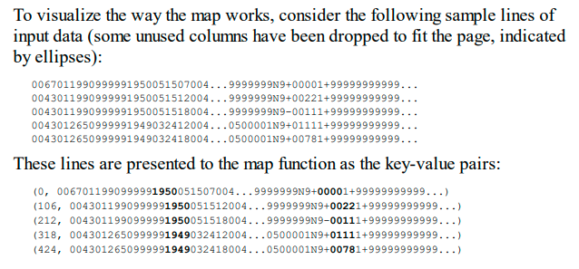
Example

Slide 7
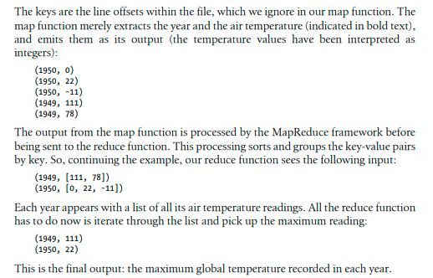

Slide 8
Map produces a new list of key/value pairs:
An output of Map is called intermediate output.
Can be the different type from input pair.
An output of map is stored on the local disk from where it is shuffled to reduce nodes.
Reduce produces a final list of key/value pairs:
An output of Reduce is called Final output.
It can be a different type from input pair.
An output of Reduce is stored in HDFS.

Slide 9
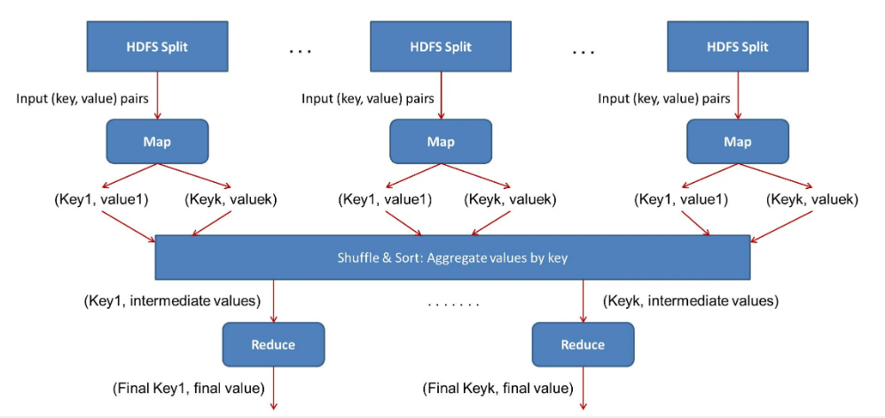
How Map Reduce Work Together

Slide 10
Map Phase
An input to a mapper is 1 block at a time. (Split = block by default)
An output of mapper is written to a local disk of the machine on which mapper is running.
Once the map finishes, this intermediate output travels to reducer nodes (node where reducer will run).
Reducer is the second phase of processing

Slide 11
By default on a slave, 2 mappers run at a time which can also be increased as per the requirements.
It depends again on factors like datanode hardware, block size, machine configuration etc.
We should not increase the number of mappers beyond the certain limit because it will decrease the performance.

Slide 12
Shuffle
Mapper in Hadoop Mapreduce writes the output to the local disk of the machine it is working. This is the temporary data.
An output of mapper is also called intermediate output. All mappers are writing the output to the local disk.
As First mapper finishes, data (output of the mapper) is traveling from mapper node to reducer node.
Hence, this movement of output from mapper node to reducer node is called shuffle.

Slide 13
MapReduce Flow chart
The data for a MapReduce task is stored in input files. Input files stay in HDFS.
InputFormat defines how these input files are split and read. InputFormat creates InputSplit.
One map task is created for each split; thus the number of map tasks will be equal to the number of InputSplits.
The split is divided into records and each record will be processed by the mapper.

Slide 14
Record reader communicates with the Input split.
Converts the data into key, value pairs suitable for reading by Mapper.
The intermediate output of Mapper is sent to the Combiner.
Combiner is also called as mini-reducer.
It performs local aggregation on the mappers’ output, which helps to minimize the data transfer between mapper and reducer. It sends the results to Partitioner.

Slide 15
Partitioner comes into the picture if we are working on more than one reducer (for one reducer partitioner is not used).
It performs partitioning. By hash function, key is used to derive partition.
According to the key value in MapReduce, each combiner output is partitioned, and a record having the same key value goes into the same partition, and then each partition is sent to a reducer.

Slide 16
Shuffling and Sorting
The output is Shuffled to the reduce node (which is a normal slave node but reduce phase will run here hence called as reducer node).
The shuffling is the physical movement of the data which is done over the network.
Once all the mappers are finished and their output is shuffled on the reducer nodes, then this intermediate output is merged and sorted, which is then provided as input to reduce phase.

Slide 17
Reducer
It takes the set of intermediate key-value pairs produced by the mappers as the input and then runs a reducer function on each of them to generate the output.
Record Writer : It writes these output key-value pair from the Reducer phase to the output files.

Slide 18
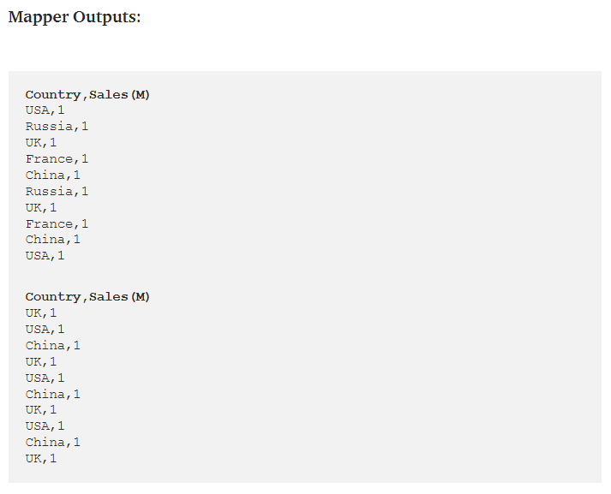

Slide 19
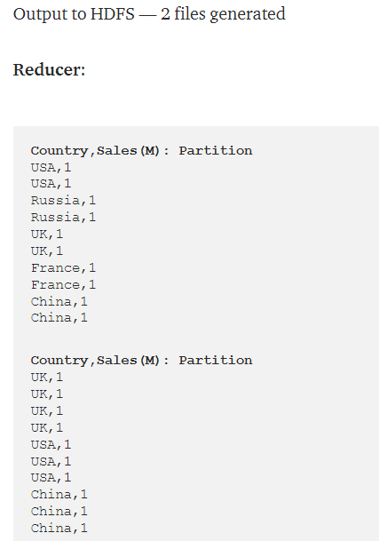

Slide 20
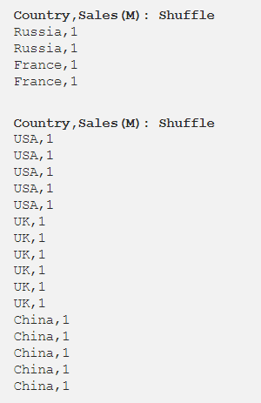

Slide 21
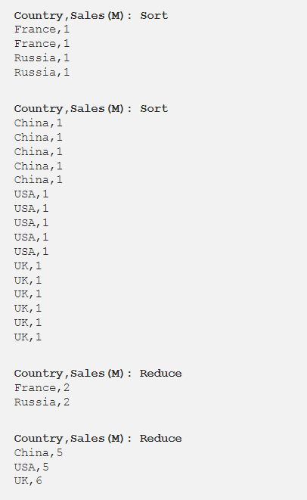

Slide 22
How Key Value Pair is Generated?
In MapReduce, map function processes a certain key-value pair and emits a certain number of key-value pairs and the Reduce function processes values grouped by the same key and emits another set of key-value pairs as output. The output types of the Map should match the input types of the Reduce as shown below:
Map: (K1, V1) -> list (K2, V2)
Reduce: {(K2, list (V2 }) -> list (K3, V3)

Slide 23
In general, the key-value pair is specified in 4 places: Map input, Map output, Reduce input and Reduce output.
Suppose, the content of the file which is stored in HDFS is John is Mark Joey is John. Using InputFormat, we will define how this file will split and read. By default, RecordReader uses TextInputFormat to convert this file into a key-value pair.
Key – It is offset of the beginning of the line within the file.
Value – It is the content of the line, excluding line terminators.
From the above content of the file-
Key is 0
Value is John is Mark Joey is John.

Slide 24
How we get the data to mapper?
We have 2 methods to get the data to mapper in MapReduce: getsplits() and createRecordReader() as shown below:
public abstract class InputFormat<K, V> { public abstract List<InputSplit> getSplits(JobContext context) throws IOException, InterruptedException;
public abstract RecordReader<K, V> createRecordReader(InputSplit split, TaskAttemptContext context) throws IOException, InterruptedException; }

Slide 25
Input Split
MapReduce InputSplit length is measured in bytes and every InputSplit has storage locations (hostname strings).
Inputsplit does not contain the input data; it is just a reference to the data.
InputFormat creates the Inputsplit and divide into records.
FileInputFormat, by default, breaks a file into 128MB chunks

Slide 26
By setting mapred.min.split.size parameter in mapred-site.xml we can control this value or by overriding the parameter in the Job object used to submit a particular MapReduce job.
The client (running the job) can calculate the splits for a job by calling ‘getSplit()’, and then sent to the application master, which uses their storage locations to schedule map tasks that will process them on the cluster.
Then, map task passes the split to the createRecordReader() method on InputFormat to get RecordReader for the split and RecordReader generate record (key-value pair), which it passes to the map function.

Slide 27
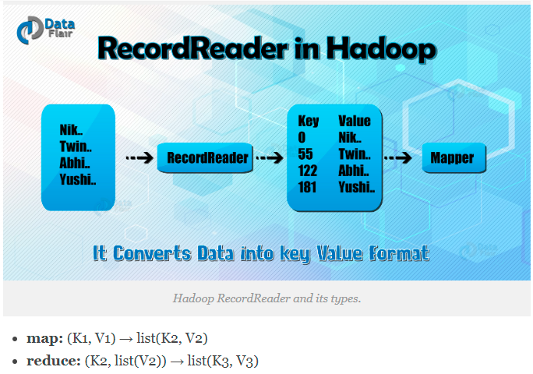
Record Reader

Slide 28
InputFormat class calls the getSplits() function and computes splits for each file.
then sends them to the JobTracker
It schedule map tasks to process them on the TaskTrackers.
Map task then passes the split to the createRecordReader() method on InputFormat in task tracker to obtain a RecordReader for that split.
The RecordReader load’s data from its source and converts into key-value pairs suitable for reading by the mapper.

Slide 29
How Hadoop RecordReader works?
A RecordReader is more than iterator over records, and map task uses one record to generate key-value pair which is passed to the map function. We can see this by using mapper’s run function:

Slide 30
public void run(Context context) throws IOException, InterruptedException{ <pre>setup(context); while(context.nextKeyValue()) { map(context.setCurrentKey(),context.getCurrentValue(),context) } cleanup(context); }

Slide 31
After running setup(), the nextKeyValue() will repeat on the context, to populate the key and value objects for the mapper.
The key and value is retrieved from the record reader by way of context and passed to the map() method to do its work.
An input to the map function, which is a key-value pair(K, V), gets processed as per the logic mentioned in the map code.
When the record gets to the end of the record, the nextKeyValue() method returns false.

Slide 32
Maximum size for a Single Record
There is a maximum size allowed for a single record to be processed. This value can be set using below parameter.
conf.setInt(“mapred.linerecordreader.maxlength”, Integer.MAX_VALUE);
A line with a size greater than this maximum value (default is 2,147,483,647) will be ignored.

Slide 33
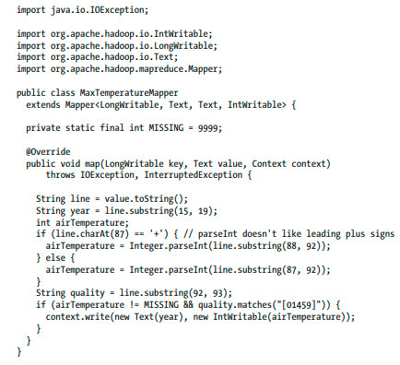
Map method

Slide 34
Map class
The Mapper class is a generic type, with four formal type parameters that specify the input key, input value, output key, and output value types of the map function.
Rather than use built-in Java types, Hadoop provides its own set of basic types that are optimized for network serialization.
These are found in the org.apache.hadoop.io package.
Here we use LongWritable, which corresponds to a Java Long, Text (like Java String), and IntWritable (like Java Integer).

Slide 35
The map() method is passed a key and a value. We convert the Text value containing the line of input into a Java String, then use its substring() method to extract the columns we are interested in.
The map() method also provides an instance of Context to write the output to.
In this case, we write the year as a Text object (since we are just using it as a key), and the temperature is wrapped in an IntWritable.

Slide 36
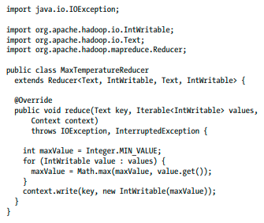
Reduce

Slide 37
